Slide 1


Slide 2
Agenda
Product Measurements
Ship Forecast Interview Findings
Sort by Store Close Removal Pilot
Intention Map

Slide 3
To be the trusted and reliable source for near real-time store and fulfillment operational analytics
VISION STATEMENT

Slide 4

Axon Team | Measures
To be the trusted and reliable source for near real-time store and fulfillment operational analytics
Reliability
Near Real-Time
Trusted
2.18 Hours
to resolve any major incident
** Goal is 3 hours
0.30 Seconds
for Axon v2 to process data
** Goal is < 0.4 Seconds
4 Incidents &
4 Procedural/Request
Axon received in June
** Goal is 7 incidents & 15 procedural
/ requests
⁶
decrease from May
Tracked as Mean Time To Resolve (MTTR)
Tracked here as Axon v2 ONLY
Tracked via Service Now Incidents
Number of Incidents & Procedurals by Month
Dec '23 = 65
Jan '24 = 56
Feb '24 = 41
Mar '24 = 80
Apr '24 = 38
May '24 = 14
Jun '24 = 8
** Data is from 6/1/2024 - 6/30/2024

Slide 5
Fulfillment Insights | Measures
Fulfillment Insights
Generate near real-time fulfillment metrics for actionable operational insights and optimizing processes
Data Availability
Data Quality
95 Days
(and counting) between any major incident
** Goal is 50 Days
88%
test coverage across all projects
** Goal is 80%
Tracked as Mean Time Between Failure (MTBF)
Tracked here as Axon v2 ONLY
** Data is from 6/1/2024 - 6/30/2024

Slide 6
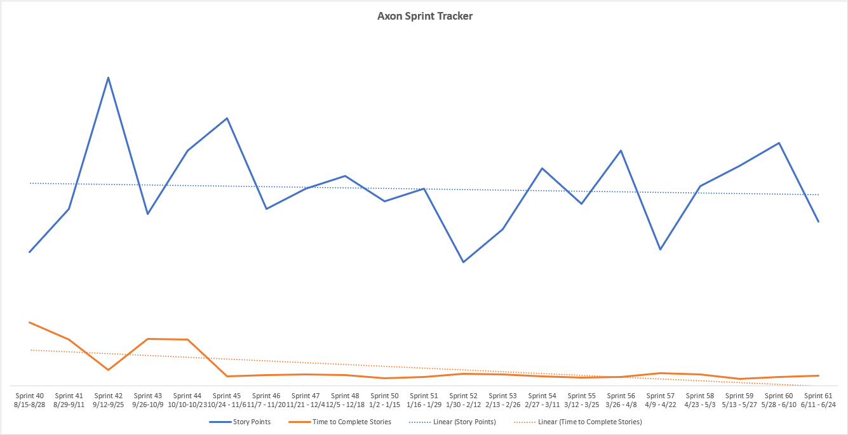
Continuous Development Efficiency | Measures
Continuous Development Efficiency
Enable Axon development to occur efficiently and effectively
Development Speed
Time to Market
Effective Deployments
Axon team develops similar outcomes faster
Axon team continuously improves the number of story points completed per sprint and reduces the time to complete stories
(See 'Axon Sprint Tracker' below)
100%
of dev deploys occur automatically
100%
of prod deploys occur with a single command
** Goal is 100% for both
Tracked via move from v1 to v2
Tracked here
Values represent Axon v2 ONLY. FPC and Axon v1 have 0% automation in both categories.
** Data is from 5/1/2024 - 5/31/2024

Slide 7
Ship Forecast Interview Findings
June 5th - 11th

Slide 8

Problem Statement
With the launch of Next Day Delivery (NDD), the Stores Ship Forecast will no longer accurately reflect the entirety of ship work needed to be executed since it will not include the NDD forecast. Additionally, the Store Leaders and Team Members are currently required to consistently compare and email containing their forecast increase against the unit plan in MPM to understand the total number of Shipping work they need to execute for the day.
How might we update the Ship forecast in both MPM and Houston to include both the typical Ship work and NDD work in an accurate and trusted way?
Major Risks
NDD forecast not being included in the Shipping Forecast in MPM
Cognitive load required for Store Team Members and Leaders to flip between email and MPM to understand the total forecast
Current source is Greenfield, which is not a technology sound solution and consistently causes problems with the Ship Forecast in MPM

Slide 9

Interview Completed
Hypothesis
We believe that modifying the existing Shipping Unit Plan (aka Staffing Forecast) in MPM to display their latest maximum shipping forecast for the Store Team Members and Leaders will achieve a trusted and accurate insight into the Shipping workload to complete for the day.
Interviews
4 Operations Directors (ODs) and 14 Store Leaders (Store Directors (SDs) and Executive Team Leads (ETLs))
Interviews were conducted via Zoom and lasted for 30 minutes
Stores were selected based on:
Variety of Regions and States
Range of % of units received vs forecast for 2023
Various Store Volumes

Slide 10
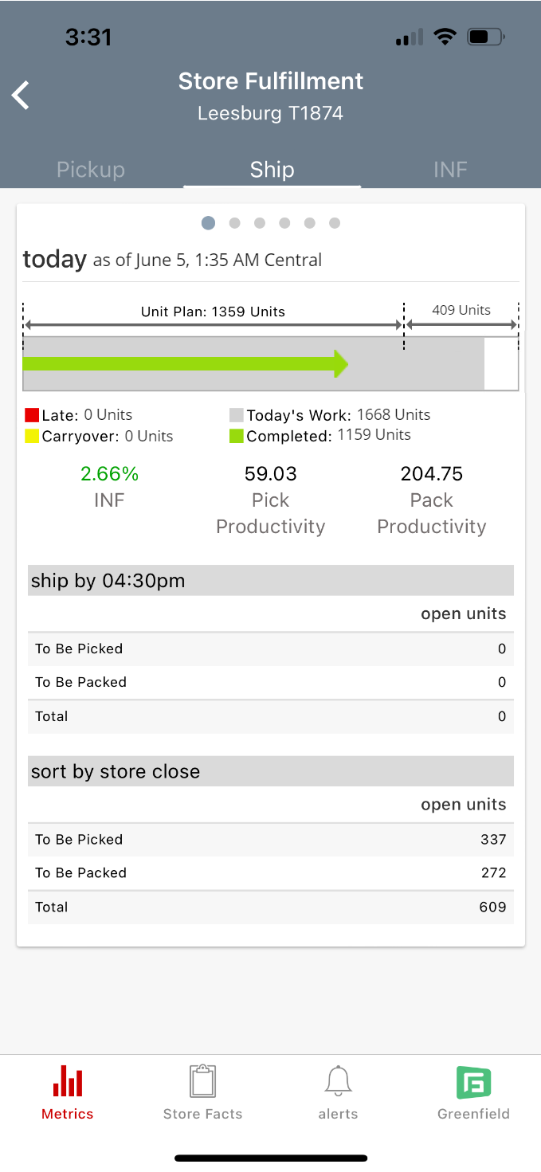
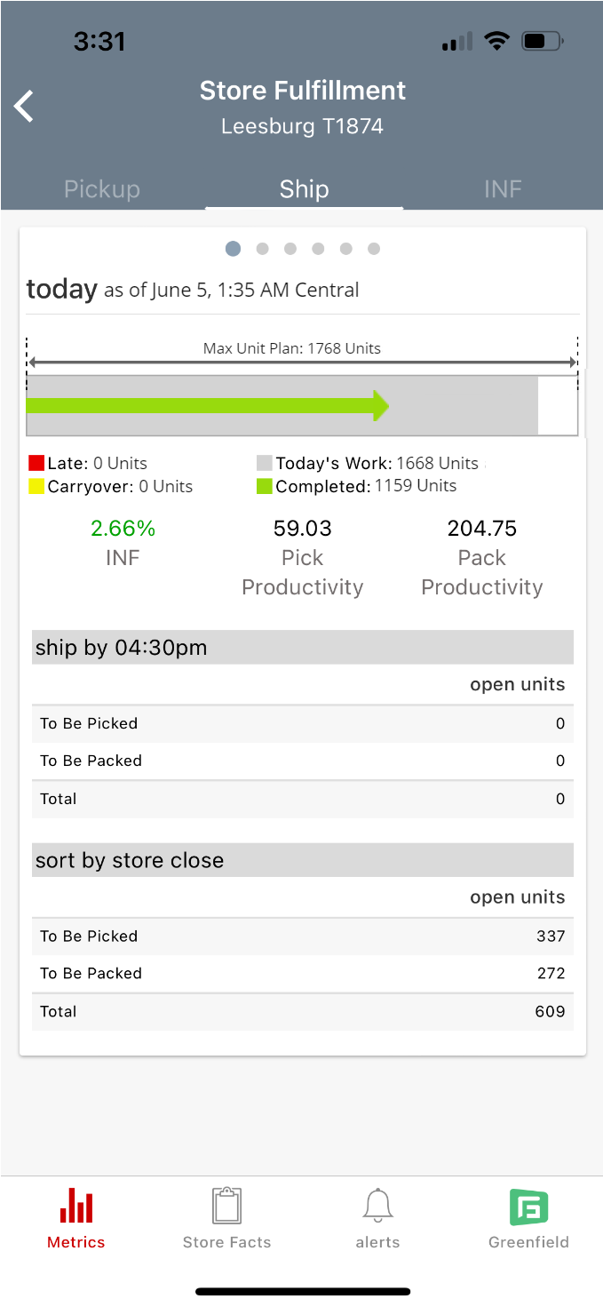
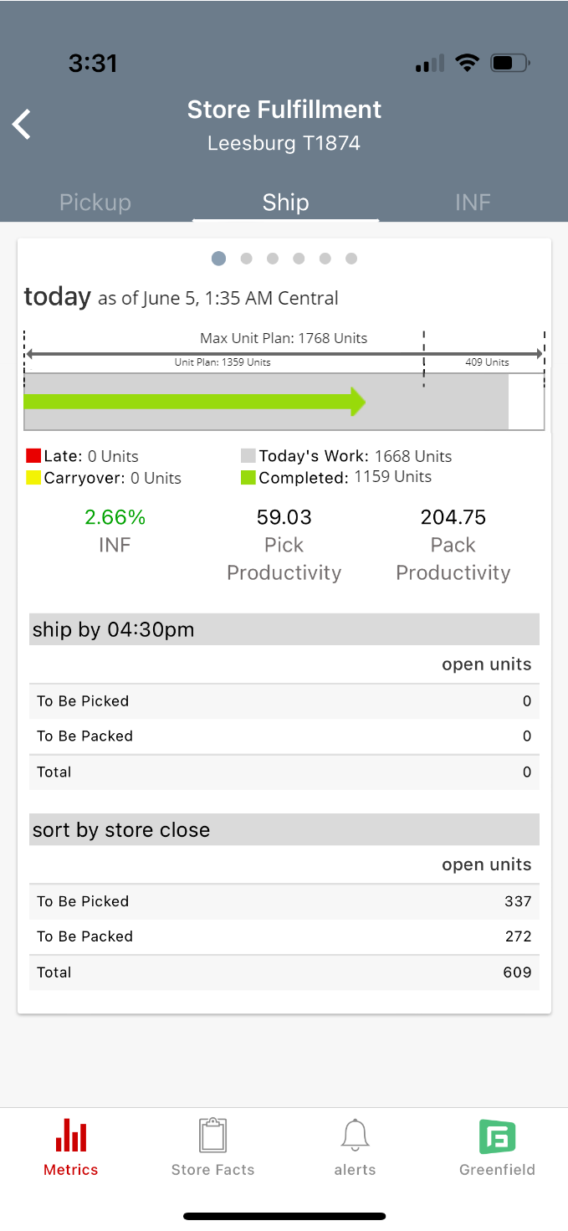
Visuals Shown during Interview
Option 1
Option 2
Option 3
Learnings
Preferred Option – Option 3 (15 out of 18) since it showed all details right on the screen; however, the screen felt overwhelming
Option 1 & 3 – Unit Plan and Additional Units were extremely clear to all participants
Option 2 – Max Unit Plan (combination of Unit Plan Additional Units) was understood by all; however, most felt this didn't provide a clear insight into forecast changes
Extremely positive feedback having the increased units directly in MPM. This eliminates the mental math done today, creates seamless communication, and understood they could receive less units.
All Store Leaders felt it was critical to display any size increase since it would allow for schedule adjustments (if needed) and set up the Closing Lead for success

Slide 11
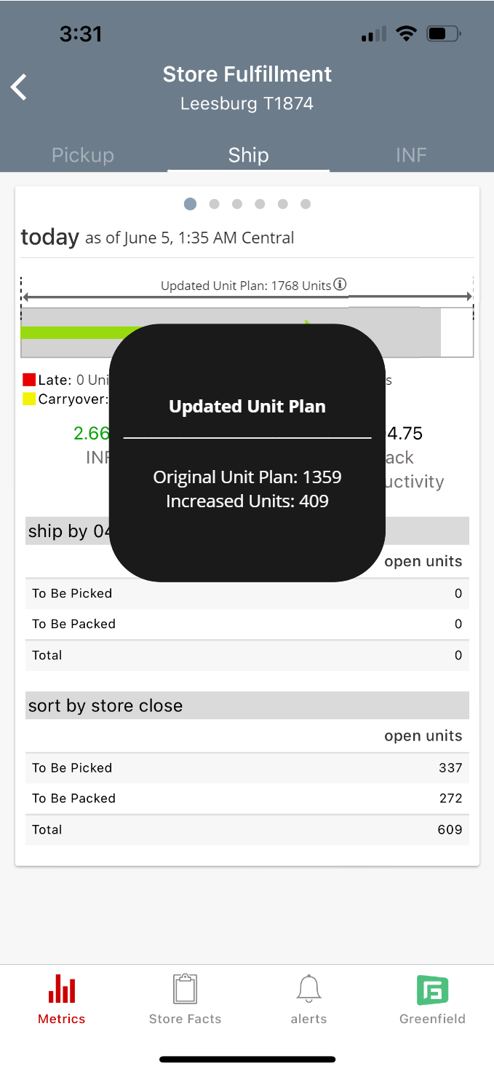
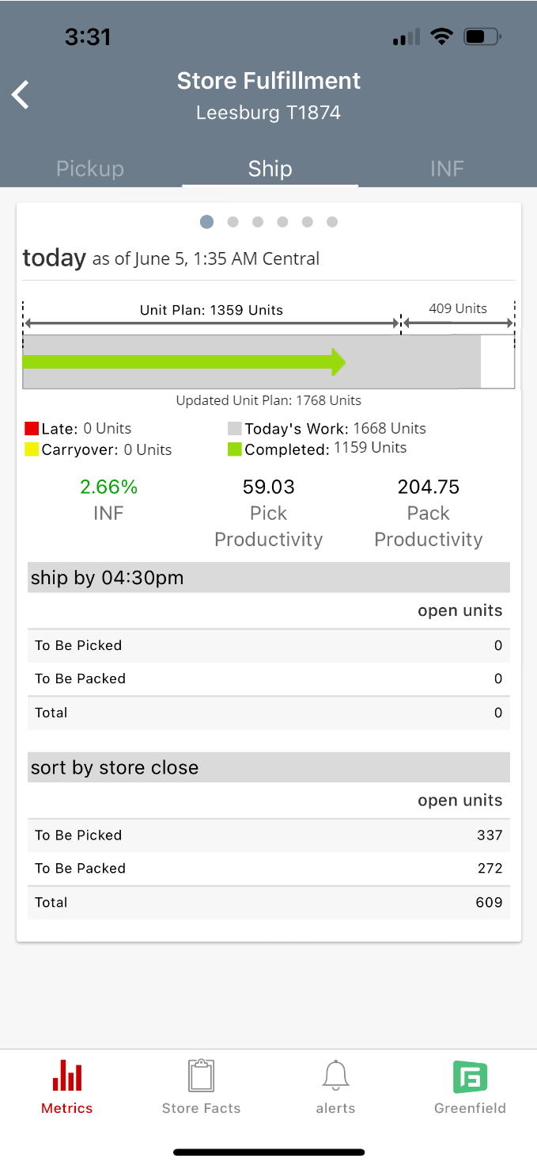
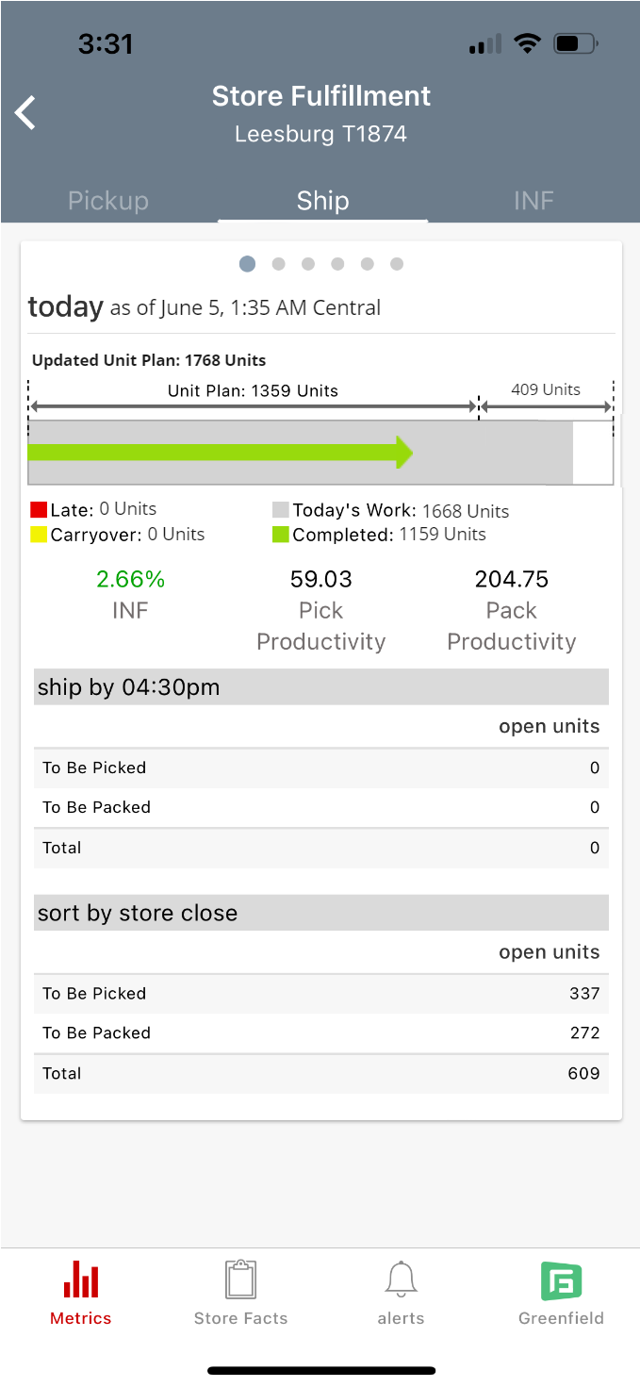
Iterated Visuals
Option 4
Option 3a
Option 3b
Learnings
Option 4 – Created to hide the details, but Leaders didn't like the pop up because it covered details
Option 3a – Created to declutter Option 3, but Leaders didn't notice 'Updated Unit Plan' at the bottom
Option 3b – Created based on 3a's feedback. Turned into the favorite option

Slide 12




Findings Summary
The option that most resonated was Option 3b
“I don’t see any reason not to like this. I don’t see anything simpler than this for the teams.”
“Don’t hold any numbers back, we want full visibility. If it’s in front of us, we have an opportunity to do something about it or have a back up plan.”
“We are constantly going back and forth to calculate and figure out where we are at. There's a lot of math. This takes away the extra step for us, and makes it easier for us”
Operations Director
Operations Director
“We have to get that green arrow to the end of the grey bar, that’s all that matters”
“Show the increase even if it's small, so we can learn the view and trust and understand it”
Store Manager
Executive Team Leader

Slide 13
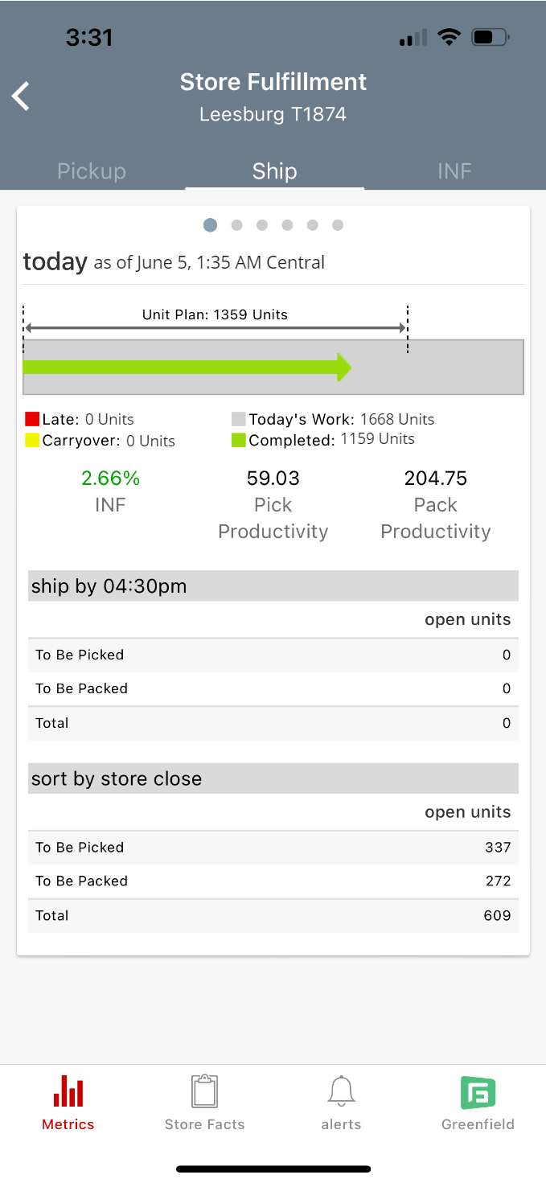
Next Steps
Add Next Day Delivery into the already existing Unit Plan value in MPM
More HQ conversations regarding how to implement showing additional unit plan values in MPM

Slide 14
Sort by Store Close Removal Pilot

Slide 15
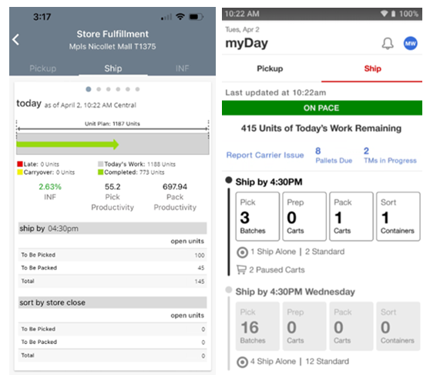
Current State
284 Stores
May 14th - Launched with first 2 Stores
T1247 (Green Bay, WI) and T2300 (Minneapolis, MN)
June 11th - Added 10 additional Stores
Milwaukee and Phoenix NDD Markets
June 25th - Added 272 additional Stores
Chicago and Minneapolis NDD Markets
Florida Stores
Balance of Chain roll out in September 2024

Slide 16
SBSC Removal Pilot
Interviewed 14 Stores
Findings / Next Steps
Problem - Comm left areas of confusion for the Store Teams and some Stores didn't see the comm
1) "Reset" comm with 284 Stores; 2) Add ~3 more stores; 3) More Store Leadership education
Problem – Some Store Teams were confused on when they should stop working
Updating myDay "Today's Work Remaining" to "Today's Work to Pack"
Problem - ODs are unable to understand if the Stores will complete all work for the end of the day
Add Remaining Today's Work to Target & RGD screens in MPM to replace SBSC value
Problem - SBSC showing 0's in MPM gave TMs indication they didn't yet receive SBSC work
Remove SBSC bucket when roll to chain
Problem - TMs finding "bugs" in Remaining Today's Work value
Waiting on more information; already completed extensive research and didn't find an issue
Measures of Success
 | Carryover % | % Completed to Units Due
Week 1 | 1.58% | 105.13%
Week 2 | 1.08% | 103.76%
Week 3 | 0.88% | 103.11%
Carryover % Baseline = 1.54% | % Completed Baseline = 101.13%

Slide 17
Axon Intention Map
Fulfillment Insights
Continuous Development Efficiency
Data Flow Optimization
NOW (End of July) | NEAR (End of Aug) | NEXT (End of Sept) | FUTURE
CAPMAN – Axon v2 ** Move CAPMAN endpoint to Axon v2 Decommission FPC-CAPMAN Outcome: FPC is successfully decommissioned for CAPMAN Decommission all applicable FPC processes for CAPMAN | Change Capabilities (GFC) Topic Outcome: Enable GFC to retire outdated fulfillment capabilities topic Retire current capabilities data connection and connect to new topic | NDD HQ Metrics Outcome: HQ TMs are able to understand how NDD is functioning in the pilot stores Add NDD metrics to Houston Event Based Progress Metrics Outcome: Store TMs can understand ship progress real time (within 1 second) Completed and Today's Work are outputted in 1 second Eliminate SBSC Outcome: Store TMs have near real-time insight into the appropriate Ship information Remove Sort by Store Close (SBSC) from Store and Roll Up screens in MPM & Houston; Replace with Remaining Today's Work NDD Forecast Outcome: Store TMs have insight into their full Shipping workload Update Ship Unit Plan to include the NDD forecast | 2024 Peak Readiness (Oct) Outcome: Axon is ready for the increased workload during peak Houston – Axon v2 ** Move axon_fulfillment_analytics endpoint to Axon v2 Decomm FPC (MPM & Houston) Outcome: FPC is successfully decommissioned for MPM and Houston Decommission all applicable FPC processes for MPM & Houston
** All Axon v2 work is to enable the outcome of "faster delivery of new functionality, reduction in development and data errors, and an easier to understand code base"

